Slide 1
Help! My Data Is Wrong!
Improving Data Quality with the Data Use Self-Assessment
California Educational Research Association (CERA) Webinar
June 2024

Slide 2
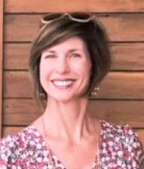
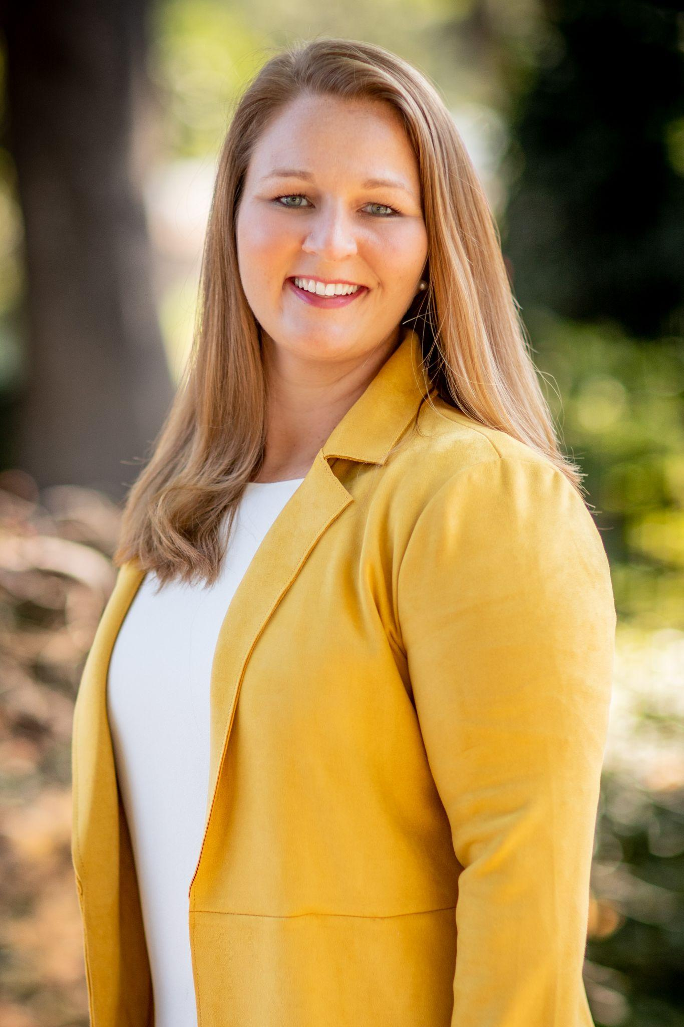
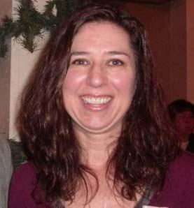
Your Presentation Team
Rachel Perry Sacramento COE
Cathy White Sacramento COE
Valerye Salazar Placer COE

Slide 3
Where Do You Work?
County Office of Education 1
Higher Education 4
School Site 3
School District 2
Research Organization 5

Slide 4
What’s One Thing You Love About Data?

Slide 5
Before We Get Started…
Identify a school or district you’re working with OR a problem in your current system.

Slide 6
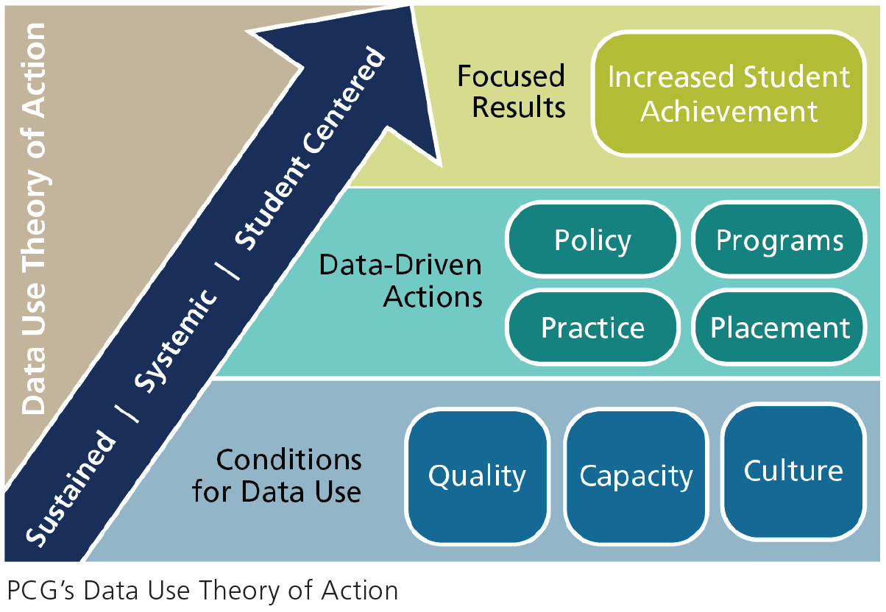
A Practical Framework for Building A Data-Driven District or School: How A Focus on Data Quality, Capacity, and Culture Supports Data-Driven Action To Improve Student Outcomes

Slide 7
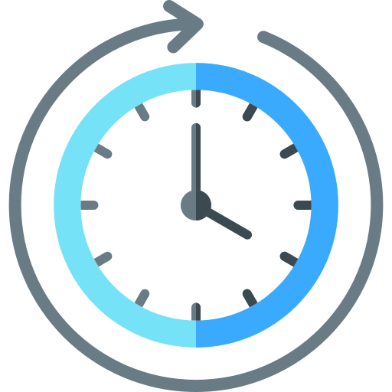
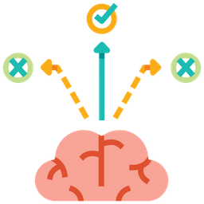
Benefits of Improving Data Quality
Productivity
Time
Cost
Consistency
Trust
Decision Making

Slide 8
The Data Is Wrong!

Slide 9
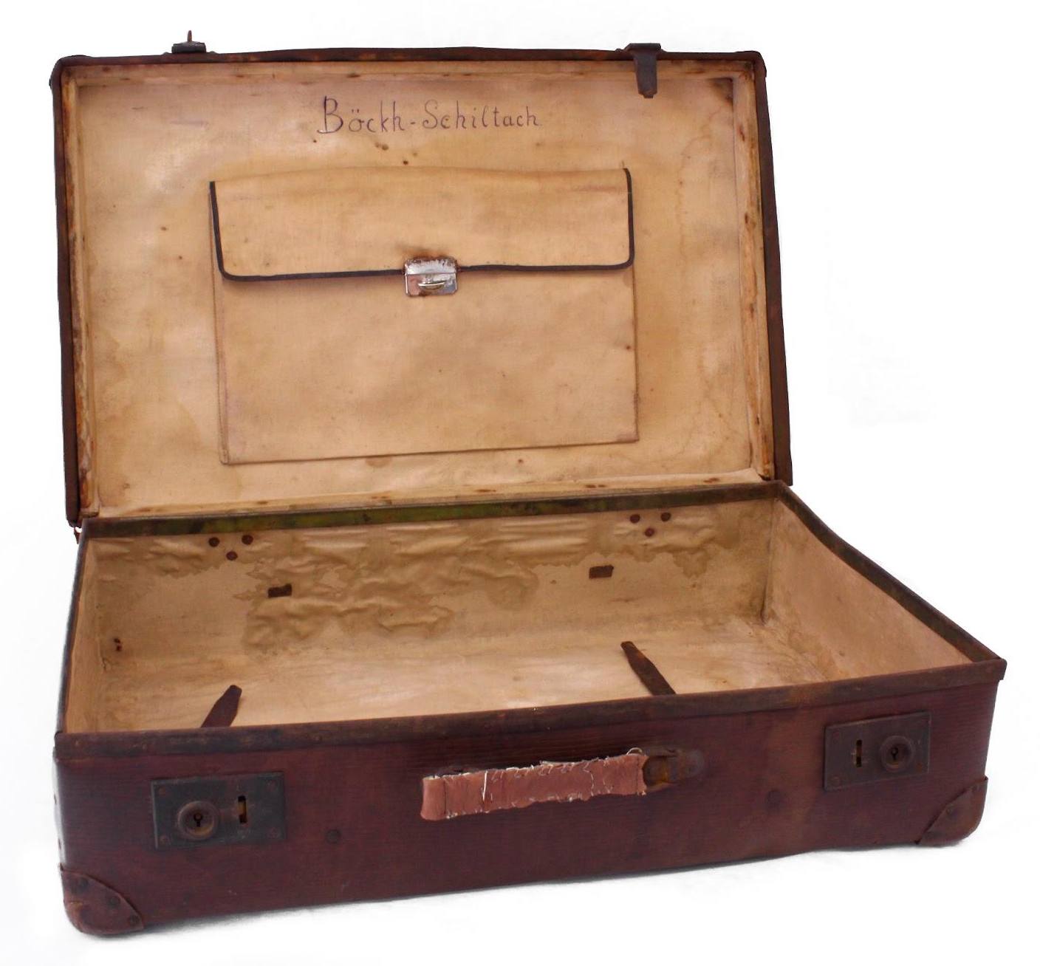
Let’s Unpack “Data Quality”
Accurate
Complete
Consistent
Timely
Available in useful ways

Slide 10
Reasons People Think the Data Is Wrong
The data in your source system is:
Incorrect The data is actually wrong | OR | Correct, but… Something is wrong with how data is flowing into other systems, making it stale or incorrect. People’s understanding of what the data represents is incorrect. Data is inconsistent between sites or departments, so looks incorrect at the district level.

Slide 11
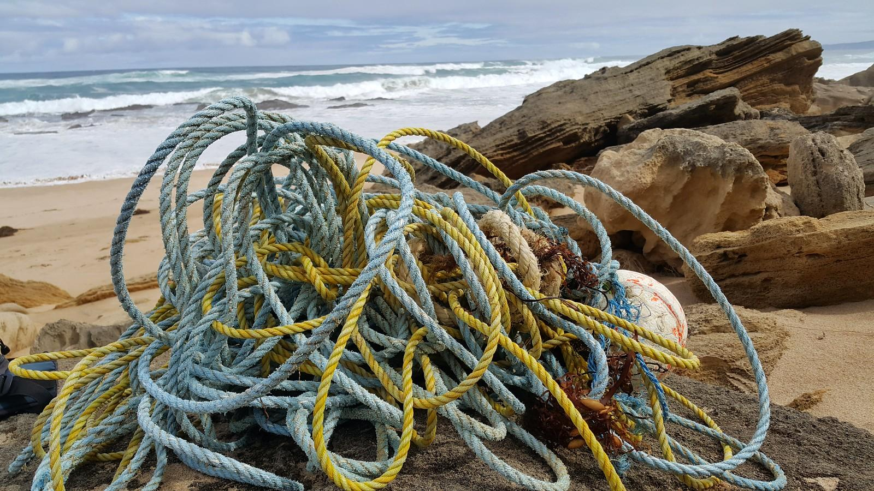
Data Problems Are Complex.
Where Do We Start?

Slide 12
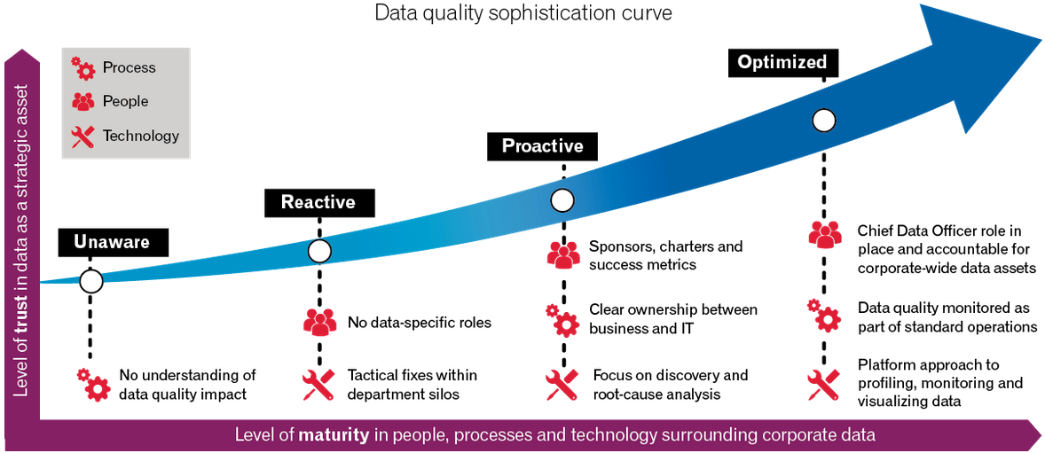
Data Quality Sophistication Curve

Slide 13
Data Use Self-Assessment (DUSA) Toolkit
Instructions for Use
DUSA and DQ DUSA
Action Plan
Facilitator’s Note Taking Guide
Google Sheets created by Imperial County
The toolkit is FREE
https://bit.ly/dusatoolkit

Slide 14
Data Use Self-Assessment (DUSA)
Four components covering:
Machine problems
People problems

Slide 15
Use the DQ DUSA to Target Data Quality

Slide 16
What’s The Plan?

Slide 17
The Data Quality Improvement Plan Has Five Steps.
Each step is aligned with Improvement Science.

Slide 18
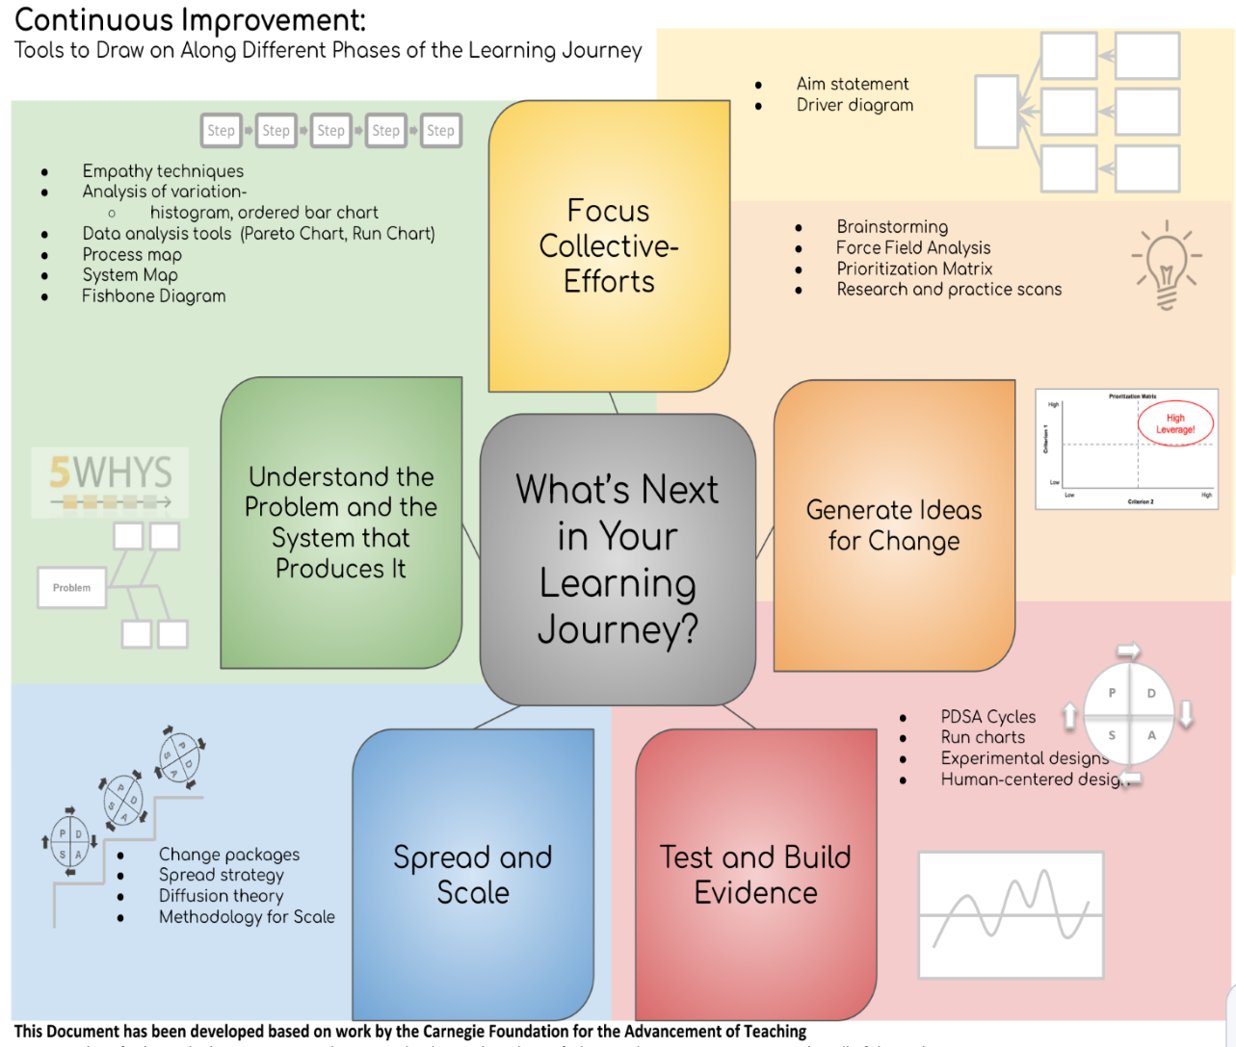
Improvement Science Provides Some Structure.

Slide 19
Step 1: Understand the Problem.
Data incorrect at the source?
Problems with imports/exports?
Data definitions incorrect or misunderstood?
Data entry inconsistent?
Other problems?
The data is wrong!
Complete a Data Quality Assessment

Slide 20
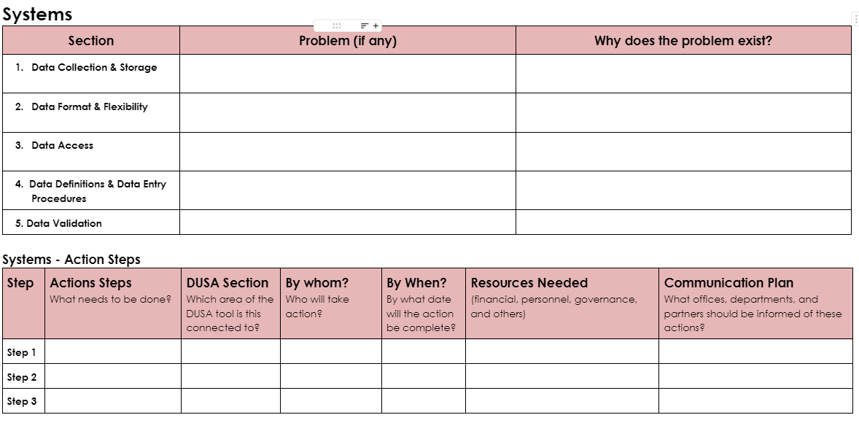
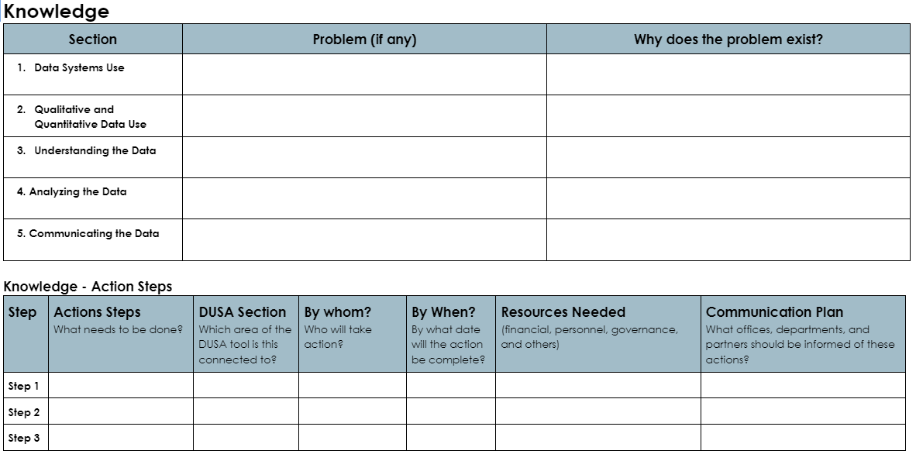
Step 1: Understand the Problem

Slide 21
Step 2: Choose a Problem

Slide 22
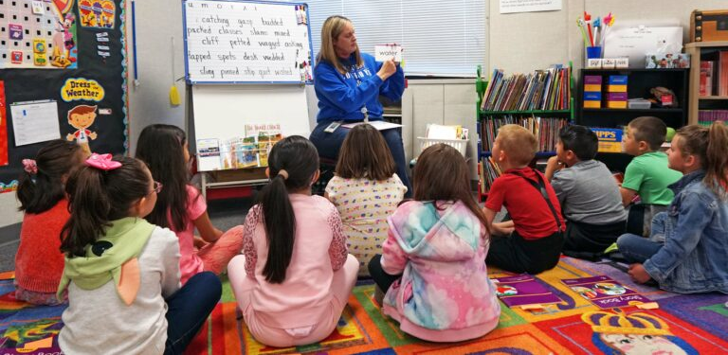
Step 3: Define WHY the Problem Matters

Slide 23
Step 4: Build the Data Quality Improvement Plan
Your Data Quality Improvement Plan will depend on:
Your data quality problems
Staffing constraints
Technical resources (systems, expertise, and access)
Competing priorities

Slide 24
Step 4: Build the Data Quality Improvement Plan
See Page 3 of the Data Quality Improvement Plan

Slide 25
Establish Data Validation Habits
Create procedures for validating data based on the problems you have observed.
Create a calendar to check data throughout the year
Assign responsibility

Slide 26
Document and Train
Data definitions for staff who enter data and “customers”
Data entry procedures
Calibration activities
Training on pulling data reports

Slide 27
Step 5: Assign Responsibility
Who is responsible for data quality?
Does this person have the skills, abilities, and authority to lead this work?
How can you set organization-wide expectations regarding data quality?

Slide 28
Data Stewardship is…
The practice of ensuring an organization’s data is accessible, trustworthy, usable, and secure.
It oversees every stage of the data lifecycle: creating and editing, preparing, using, storing, and archiving…

Slide 29
Assign Data Stewards
Data Stewards may:
Maintain data definitions
Document procedures
Train staff
Create validation processes and calendars
“Certify” data
Ensure data is secure

Slide 31
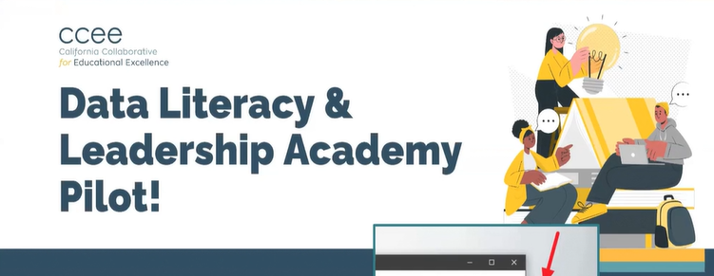
New Opportunity
In partnership with the San Diego COE.
Courses for data analysts new to K-12 and emerging data leaders https://ccee-ca.org/resources/data-literacy-leadership-academy/

Slide 33
Contact Us!
Capital Central Foothill Area Consortium Data Huddle
Rachel Perry
rperry@scoe.net
Valerye Salazar
vsalazar@placercoe.org
Cathy White
cwhite@scoe.net

